Slide 1
Chapter 1-2

Slide 2
Question1
( ) 1. From the view of computer architecture, the machine attributes that assembler programmer can see are _______.
A. the functions to be accomplished by computer software.
B. the organization of all computer hardware.
C. the hardware abstraction to be used when programming.
D. the hardware implementation of the various computer components
Notes:
C

Slide 3
Question2
( )2 . Which of the following descriptions about “Computer architecture” is true?
Computer architecture refers only to instruction set architecture design.
Computer architecture means the implementation of a machine, which has two components: organization and hardware.
Computer architecture design doesn’t need to provide support to compilers.
Computer architecture is intended to cover all three aspects of computer design ---- instruction set architecture, organization and hardware.
Notes:
D

Slide 4
Computer Design Engineering life cycle
Evaluating Existing
Systems for
Bottleneck(app.B)
Benchmarks(1.8)
User requirement
Analysis(1.2)
Quantitative Principles
1.9
Technology Trend 1.4
Power Trend 1,5
Cost Trend 1.6
Application Trend 1,7
Implement Next
Generation System
Simulate New
Designs and
Organizations
Workloads
Evaluating for price peformance(1.8)
Notes:
Requirement Analysis:
Market analysis: who you will sell 4-1.2
desktop, server, embedded system, HPC
Different markets has different driven motivations.
When design a desktop, it aims to obtain best price-performance.
For the servers, dependability is critical, then the scalability, and throughput.
For the embedded computer systems, price is a key factor, while real-time performance is important . And power efficiency and memory size is always under consideration.
2. Functional requirement: 4-1.3
3. Performance requirement:
4. Power
5. Unfuntional requirements: availability, dependibility 1.7
7. Cost/price

Slide 5
Topics in Chapter
1.1 Introduction
1.2 Classes of computers
1.3 Defining computer architecture and What’s the task of computer design?
1.4 Trends in Technology
1.5 Trends in power in Integrated circuits
1.6 Trends in Cost
1.7 Dependability
1.8 Measuring, Reporting and summerizing Perf.
1.9 Quantitative Principles of computer Design
1.10 Putting it altogether

Slide 6
Classification-market
Embedded system
2010s
19 billion
Mainframe
1960s
PC
2010
350 million
Mini-
Supercomputer
1970s
Mini-
Computer
1970s
Supercomputer
1970s
Work-
Station
1980s-2000s
personal mobile device
2010s
1.8 billion
Server
2010s
20 million
Massively Parallel Processors
1980s

Slide 7
5 computing markets
Feature | PMD | Desktop | Server | Clusters | Embedded
Price of system | $100-$1000 | $300-$2500 | $5000 -$10,000,000 | $100000-$200,000,000 | $10 -$100,000
Price of microprocessor module | $10-$100 | $50-$500 per proc. | $200 -$2,000 per proc. | $50-$250 | $0.01 -$100 per proc.
Critical system design issues | Cost, energy, Media perf. responsiveness | Price-perf., Energy, Graphics perf. | Throughput, availability, Scalability, energy | Price-perf., Throughput, energy proportionality | Price, energy, application-specific perf.
Notes:
Personal mobile device

Slide 8
Personal Mobile Devices
Wireless devices with multimedia user interfaces
Application
Web-based， media-oriented
Responsiveness， predictability
Requirement:
Cost, energy efficiency ( battery, no-fan)
Real-time performance
Minimize memory → flash memory

Slide 9
Desktop Computing
The first, and still the largest market in dollar terms, is desktop computing. （laptop > 50% market of desktop )
Requirement:
Optimized price-performance
highest-perf. & cost-reduced Microprocessor appear first in desktop systems
New challenges:
Web-centric, interactive application
How to evaluate performance ?

Slide 10
Servers
The role of servers to provide larger scale and more reliable file and computing services grew.
Requirement:
First, availability is critical.
A second key feature of server systems is an emphasis on scalability. →memory,storage and I/O bandwidth is crucial.
Lastly, servers are designed for efficient throughput.

Slide 11
Cost with downtime
Application | Cost of downtime per hour | 1% 87.6 hrs/yr | 0.5% 43.8 hrs/yr | 0.1% 8.8 hrs/yr
Brokerage operations | $6,450,000 | $565,000,000 | $283,000,000 | $56,500,000
Credit card authorization | $2,600,000 | $228,000,000 | $114,000,000 | $22,800,000
Package shipping services | $150,000 | $13,000,000 | $6,600,000 | $1,300,000
Home shopping channel | $113,000 | $9,900,000 | $4,900,000 | $1,000,000
Catalog sales center | $90,000 | $7,900,000 | $3,900,000 | $800,000
Airline reservation center | $89,000 | $7,900,000 | $3,900,000 | $800,000
Cellular service activation | $41,000 | $3,600,000 | $1,800,000 | $400,000
Online network fees | $25,000 | $2,200,000 | $1,100,000 | $200,000
ATM service fees | $14,000 | $1,200,000 | $600,000 | $100,000

Slide 12
Cluster/Warehourse-Scale Computers
SaaS (Search,social networking, video sharing, multiplayer games, online-shopping)
WSC—tens of thousands of servers act as one
Requirements:
Price-performance, Power ( 10% saves $7M )
Availability is critical
Scalability ( Note the difference with server )
(Note the difference with supercomputer)

Slide 13
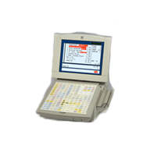
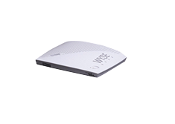
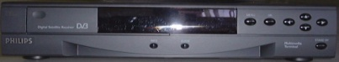
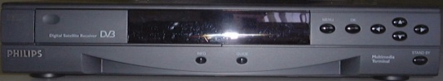
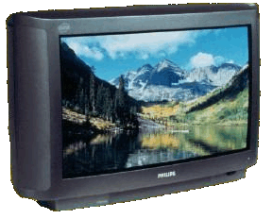
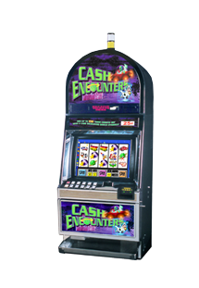
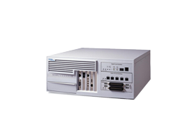
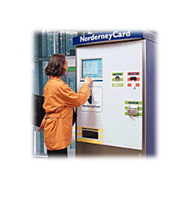
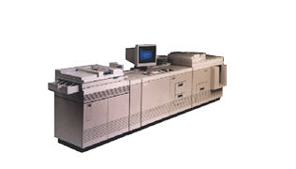
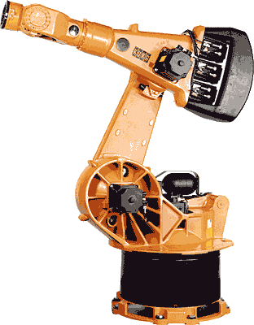
Embedded systems
Retail POS
Thin Clients
Set-Top-Box
Gateway/Media Store
Network Devices
Intel® Architecture
Intel® XScale™
Kiosk/ATM
Game Platforms
Office Automation
Industrial Automation

Slide 14
Embedded Computers
The fastest growing portion of the computer market with widest spread of processing power and cost.
Requirements
Real time performance (soft & hard)
Strict resource constraints
limited memory size, lower power consumption,...
The use of processor cores together with application-specific circuitry.
DSP, mobile computing, mobile phone, Digital TV

Slide 15
Other classification
Quantum computer vs Chemical computer,
Scalar processor vs Vector processor
Non-Uniform Memory Access (NUMA)/ UMA
Register machine vs Stack machine vs Accumulater machine
Harvard architecture vs Von Neumann architecture
/Non Von Neumann architecture （ 类脑芯片：达尔文2）
RISC vs. CISC
Cellular architecture
Notes:
Cellular architecture takes multi-core architecture design to its logical conclusion, by giving the programmer the ability to run large numbers of concurrent threads within a single processor. Each 'cell' is a compute node containing thread units, memory, and communication. Speed-up is achieved by exploiting thread-level parallelism inherent in many applications.

Slide 16
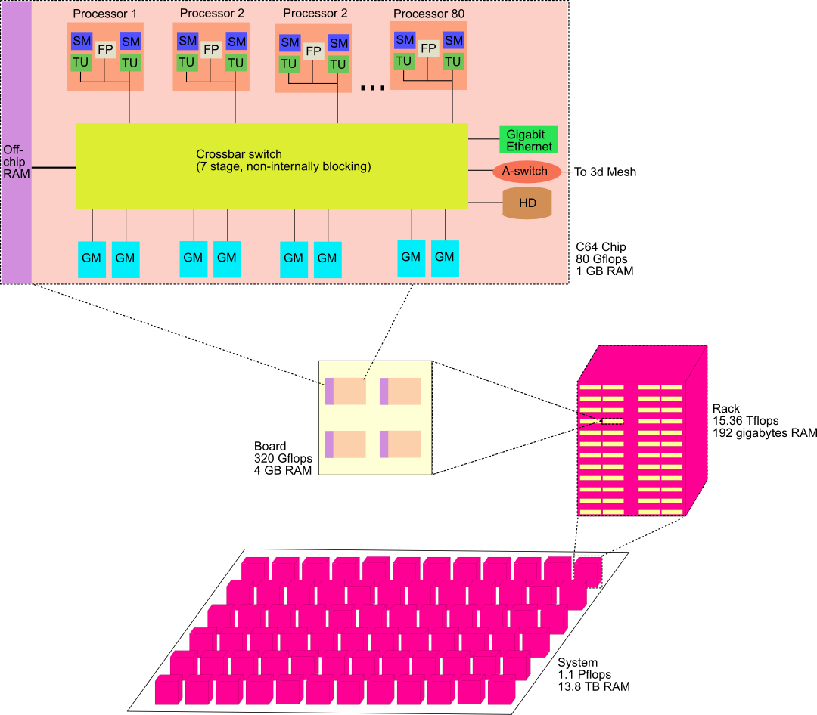
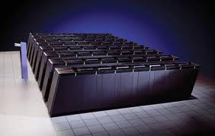
Cellular architecture
Cyclops64 (known as Blue Gene/C)
IBM's Cell microprocessor is the first one to reach the market.
Cellular architecture takes multi-core architecture design to its logical conclusion, by giving the programmer the ability to run large numbers of concurrent threads within a single processor. Each 'cell' is a compute node containing thread units, memory, and communication. Speed-up is achieved by exploiting thread-level parallelism inherent in many applications.

Slide 17
Classes of Parallelism and Parallel Architecture
Two kinds of parallelism in application
Data-level Parallelism（DLP）
Task-level Parallelism （TLP）
Hardware exploit in 4 major ways
Instruction level Parallelism
Vector Architecture and GPUs
Thread-Level Parallelism
Request-Level parallelism

Slide 18
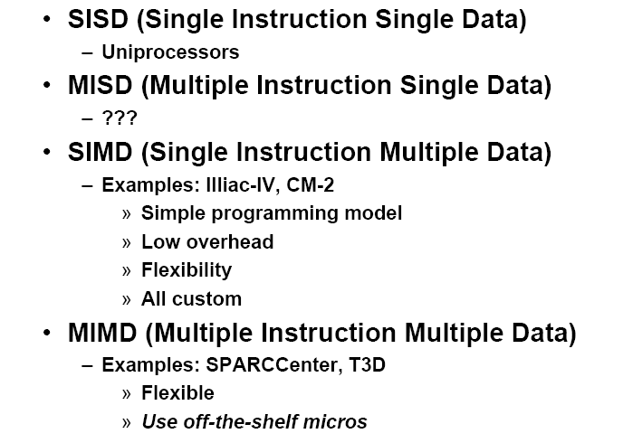

Classes of computers
Flynn’s Taxonomy: A classification of computer architectures based on the number of streams of instructions and data
Notes:
Proposed at 1966.
^ Flynn, M., Some Computer Organizations and Their Effectiveness, IEEE Trans. Comput., Vol. C-21, pp. 948, 1972.
^ Duncan, Ralph, "A Survey of Parallel Computer Architectures", IEEE Computer. February 1990, pp. 5-16.

Slide 19
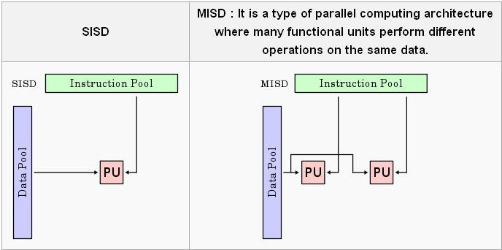
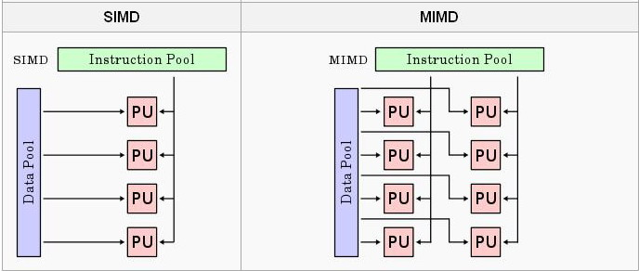
classification

Slide 20
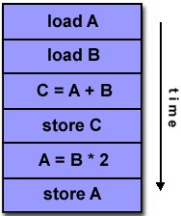
SISD
A serial (non-parallel) computer
Single instruction: only one instruction stream is being acted on by the CPU during any one clock cycle
Single data: only one data stream is being used as input during any one clock cycle
Deterministic execution
This is the oldest and until recently, the most prevalent form of computer
Examples: most PCs, single CPU workstations and mainframes

Slide 21
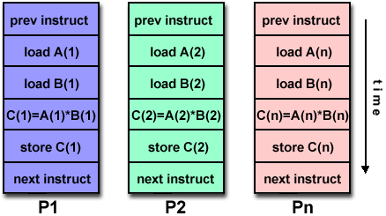
SIMD
A type of parallel computer
Single instruction: All processing units execute the same instruction at any given clock cycle
Multiple data: Each processing unit can operate on a different data element
This type of machine typically has an instruction dispatcher, a very high-bandwidth internal network, and a very large array of very small-capacity instruction units.
Best suited for specialized problems characterized by a high degree of regularity,such as image processing.
Synchronous (lockstep) and deterministic execution
Two varieties:
Processor Arrays: Connection Machine CM-2, Maspar MP-1, MP-2
Vector Pipelines: IBM 9000, Cray C90, Fujitsu VP, NEC SX-2, Hitachi S820

Slide 22
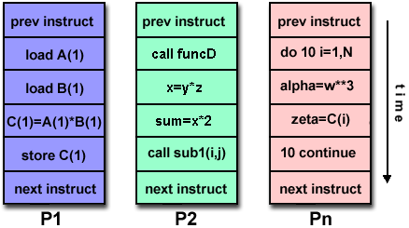
MIMD
Currently, the most common type of parallel computer. Most modern computers fall into this category.
Multiple Instruction: every processor may be executing a different instruction stream
Multiple Data: every processor may be working with a different data stream
Execution can be synchronous or asynchronous, deterministic or non-deterministic
Examples: most current supercomputers, networked parallel computer "grids" and multi-processor SMP computers - including some types of PCs.

Slide 23
Topics in Chapter
1.1 Why take this course ?
1.2 Classes of computers in current computer market
1.3 Defining computer architecture and What’s the task of computer design?
1.4 Trends in Technology
1.5 Trends in power in Integrated circuits
1.6 Trends in Cost
1.7 Dependability
1.8 Measuring, Reporting and summerizing Perf.
1.9 Quantitative Principles of computer Design
1.10 Putting it altogether

Slide 24
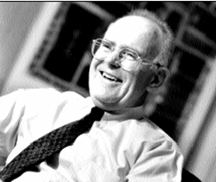
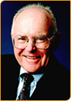
Technology Trends
Moore Law
In 1965 he predicted that the number of components the industry would be able to place on a computer chip would double every year. In 1975, he updated his prediction to once every two years. It has become the guiding principle for the semiconductor industry to deliver ever-more-powerful chips while decreasing the cost of electronics.
Gordon Moore

Slide 25
Gordon Moore on Moore’s law
Moore’s brief Bio
http://www.intel.com/pressroom/kits/bios/moore.htm
Gordon Moore on Moore’s law
http://www.sichinamag.com/Article/html/2007-09/2007919032802.htm
Video on conversation with Moore
http://you.video.sina.com.cn/b/7076856-1282136212.html

Slide 26
Technology Trends
Integrated circuit logic technoloty
Transistor(晶体管) Density: incr. 35% per year, (4x every 4 years)
Die size: 10%-20% per year
Transistor count per chip:40-55% per year or 2x 10 to 24 months
Semiconductor DRAM
Capacity per DRAM: 25%-40% per year (2x every 2-3 years)
Memory speed: about 10% per year
Might stop and may be replaced
Semiconductor Flash – standard storage device in PMDs
Capacity per flash chip：50-60% per year （ 2x every 2 years）
15-20 times cheaper than DRAM
Magnetic Disk tech.
Desnsity: 30% p.y. Before 1990; 60% p.y. 1990-1996
100 p.y. 1996-2004 ; 30% p.y. after 2004
capacity: about 60% per year
Network
bandwidth: 10Mb ⎯⎯⎯→ 100Mb ⎯⎯⎯→ 1Gb
10 years 5 years
Designers often design for the next technology.

Slide 27
Improvement of DRAM rate
AQA Edition | Year | DRAM growth | Characterization of impact on DRAM capacity
1 | 1990 | 60% / year | Quadrupling every 3 years
2 | 1996 | 60% / year | Quadrupling every 3 years
3 | 2003 | 40%-60%/ year | Quadrupling every 3 to 4 years
4 | 2007 | 40% / year | Doubling every 2 years
5 | 2011 | 25% - 40% / year | Doubling every 2 - 3 years
Notes:
4倍的

Slide 28
Import Notes
A rule of thumb
Cost decrease rate ~ density increase rate
Technology thresholds
Technology improves continuously, an impact of this improvements can be in discrete leaps.

Slide 29
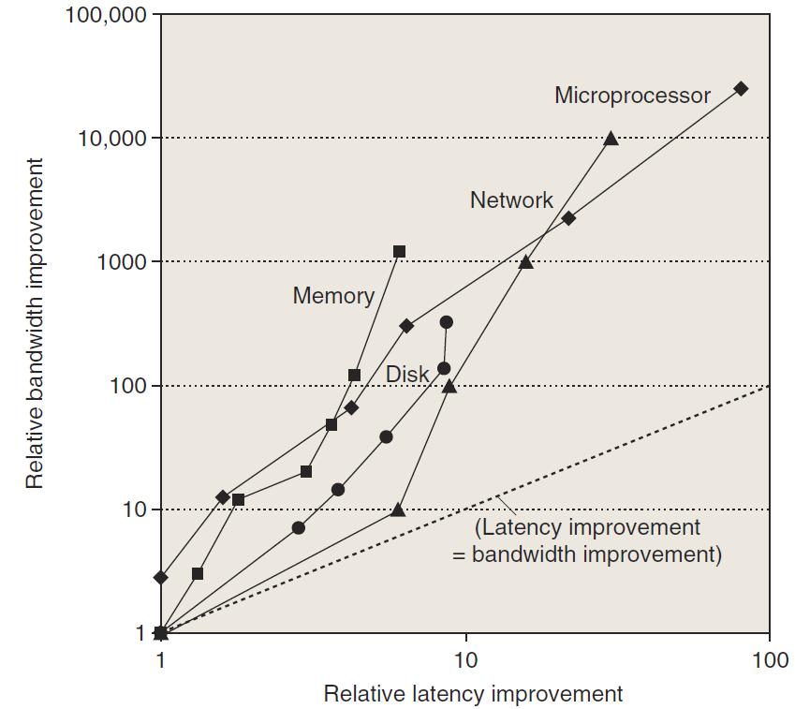
Perf. Trends: Bandwidth over latency
Bandwidth/throughput: total amount of work done in a given time
Latency/response time: the time between the start and the completion of an event.
Rule of thumb
Bandwidth grow rate ~ improvement in latency²
10，000X—25，000X in Bandwidth
30X—80X in latency

Slide 30
Performance milestones in microprocessor

Slide 31
Challenges for IC Tecnology
IC characteristic: feature size(特征尺寸）
10 microns in 1971 → 0.18microns in 2001
→ 0.09 microns in 2006 → 0.032 microns in 2011
7nm is under way.
Rule of thumb: transistor perf. Improves linearly with decreasing feature size.
IC density improvement is both opportunity and Challenge:
signal delay for a wire increase in proportion to the product of its resistance and capacitance.
Wire delay---major design limitation

Slide 32
Bad prediction with big guy
“There is no reason anyone would want a computer in their home.”
--Ken Olson, president,
Chairman and founder of Digital Equipment Corp., 1977

Slide 33
Topics in Chapter
1.1 Why take this course ?
1.2 Classes of computers in current computer market
1.3 Defining computer architecture and What’s the task of computer design?
1.4 Trends in Technology
1.5 Trends in power and Energy in Integrated circuits
1.6 Trends in Cost
1.7 Dependability
1.8 Measuring, Reporting and summerizing Perf.
1.9 Quantitative Principles of computer Design
1.10 Putting it altogether

Slide 34
Trends in Power
Power also provide challenges as device scaled
first microprocessor: 1/10watt -->
2GHz P4: 135watt
Challenges:
distributing the power
removing the heat
preventing hot spot

Slide 35
Techiques to save engery
Do nothing well----stop the clocks when cores are idle.
Dynamic Voltage – Frequency Scaling (DVFS，动态电压频率调整)
A few clock frequency and voltages
Design for typical case
Lower power modes（LPM） –save power
Can not access DRAM or disk when in LPM
Overlocking
Turn off all cores but one and run at higher clok rate.
Race-to-halt
Use a faster， less energy-efficient processor to allow the rest of the system to go into a sleep mode

Slide 36
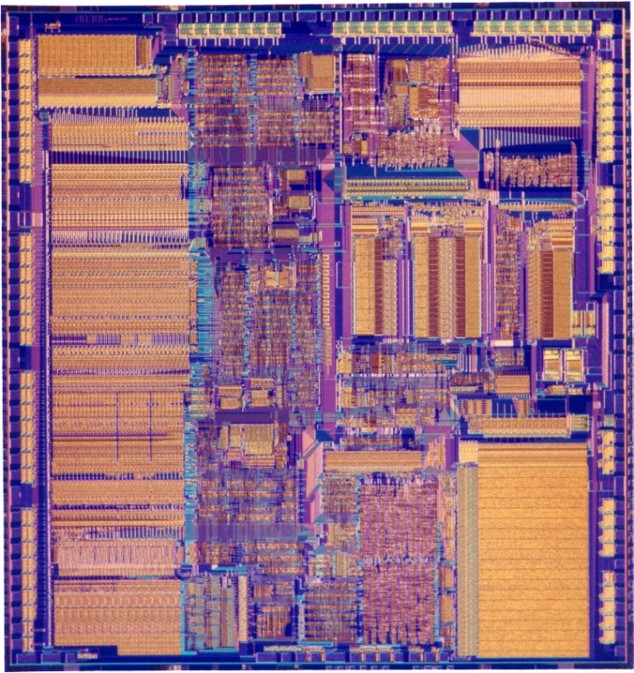
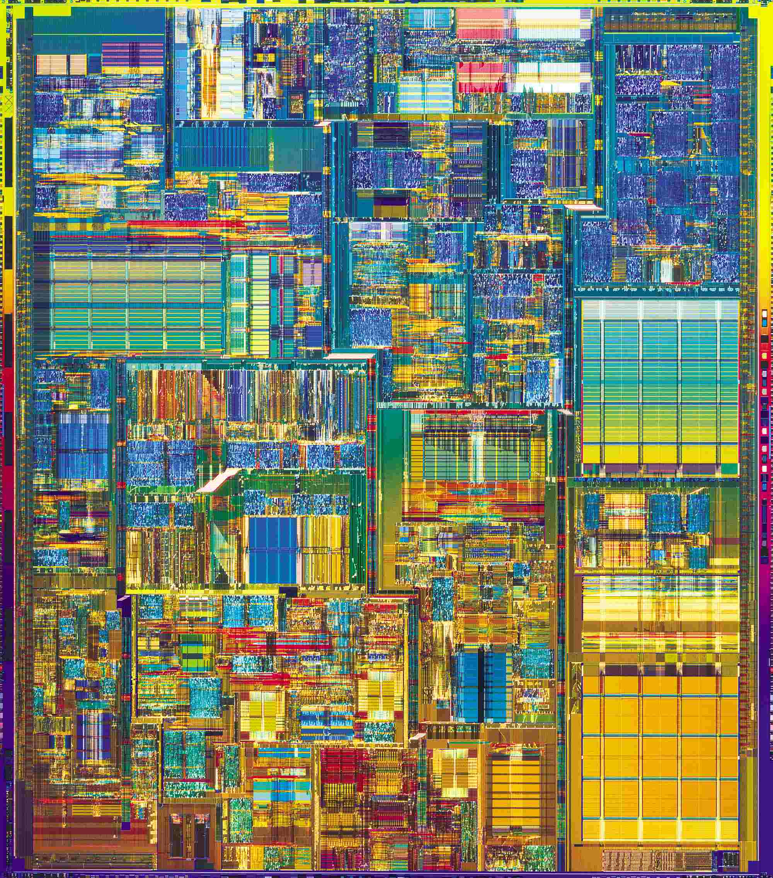
Compare the performance / power
Pentium® 4 Processor
386 Processor
May 1986
@16 MHz core
275,000 1.5µ transistors
~1.2 SPECint2000
17 Years
200x
200x/11x
1000x
August 27, 2003
@3.2 GHz core
55 Million 0.13µ transistors
1249 SPECint2000

Slide 37
Power efficiency
Power efficiency has dropped
Performance scales with area**.5

Slide 38
Two concepts
Dynamic power: power consumption in switching transistors.
Power _{dynamic} = ½ *Capacitive load * Voltage² * Frequency switched
Energy _{dynamic} = Capacitive load * Voltage²
Static power: power consumption when a transistor is off due to power leakage
Power _{static} = current static * Voltage

Slide 39
Rule of Thumb
10% reduction of voltage yields
10% reduction in frequency
30% reduction in power
Less than 10% reduction in performance
Rule of Thumb
Voltage | Frequency | Power | Performance
1% | 1% | 3% | 0.66%

Slide 40
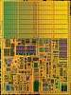
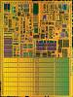
Dual core with voltage scaling
RULE OF THUMB
A 15%
Reduction
In Voltage
Yields
Frequency Reduction | Power Reduction | Performance Reduction
15% | 45% | 10%
SINGLE CORE
DUAL CORE
Area = 1
Voltage = 1
Freq = 1
Power = 1
Perf = 1
Area = 2
Voltage = 0.85
Freq = 0.85
Power = 1
Perf = ~1.8

Slide 41
Multiple cores deliver more performance per watt
Cache
Power
Big core
4
3
Performance
2
2
Small
core
1
1
1
1
Many core is more power efficient
Power ~ area
Single thread performance ~ area**.5
C1
C2
4
4
Cache
3
3
C3
C4
2
2
1
1

Slide 42
Why Multicore?

Slide 43
Topics in Chapter
1.1 Why take this course ?
1.2 Classes of computers in current computer market
1.3 Defining computer architecture and What’s the task of computer design?
1.4 Trends in Technology
1.5 Trends in power in Integrated circuits
1.6 Trends in Cost
1.7 Dependability
1.8 Measuring, Reporting and summerizing Perf.
1.9 Quantitative Principles of computer Design
1.10 Putting it altogether

Slide 44
Major Theme: Lower Cost
Cost Trend
Understanding cost trends of component is important for designers, since we design for tomorrow !
The impact factors for cost:
Time----Component prices drop over time without major improvements in manufacturing technology
Volume ----Volume decreases cost due to increases in manufacturing efficiency.
Commodification----The competition among the suppliers of the components will decrease overall product cost.

Slide 45
Understanding Cost Trend by Learning Curve

Slide 46
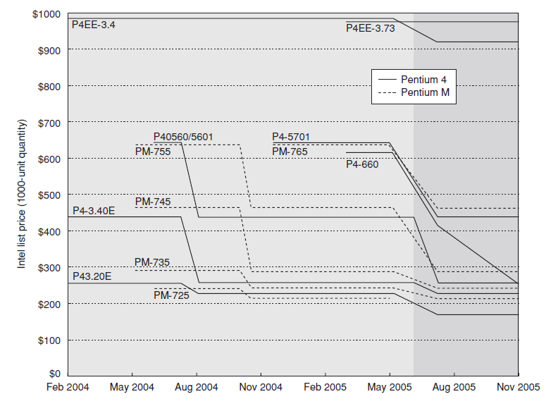
Price of Pentium4 & PentiumM

Slide 47
Rules of Thumb
Time: learning curve ----yield
Twice the yield will have half the cost.(for chip, board, or a system)
Volume:
Cost decrease about 10% for each doubling of volume.
Commodities:
Vendor competition
Supplier competition
Volume increase, however limited profits.
Notes:
Volume affect the cost
缩短了learning curve下拐的时间, 下降的时间与制造的系统数量部分成正比.
提高了购买和制造效率,降低成本
数量会减少开发成本,因为成本是分摊到各台计算机的.

Slide 48
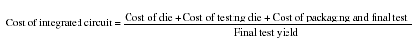
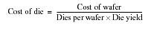
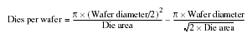
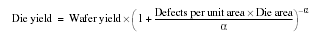
Cost of an Integrated Circuit

Slide 49
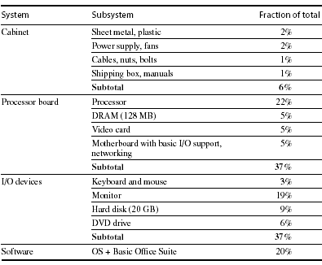
Distribution of Cost in a System

Slide 50
Cost vs. Price
Component costs
Raw material cost.
Direct cost:
Costs incurred to make a single item. Adds 20% to 40% to component cost.
Gross margin ( Indirect cost):
Overhead not associated with a single item, i.e. R&D, marketing, manufacturing equipment, taxes, etc.
Only 4%-12% of income are spent on R&D
Average Selling Price (ASP):
Component cost + direct cost + indirect cost.
List price :
Not ASP. Stores add to the ASP to get their cut. Want 50% to 75% of list price.

Slide 51
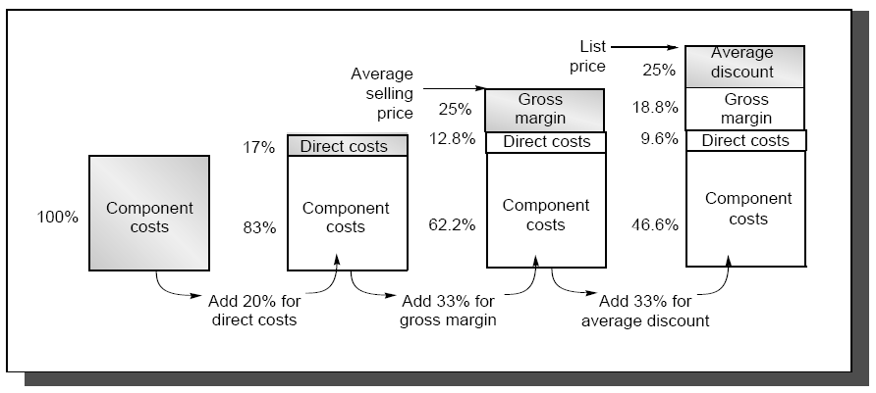
The components of price for a $1000 PC

Slide 52
Cost vs. Price
This gives you insight on how a design decision will affect selling price,
i.e. changing cost by $1,000 increases selling price by $3,000 to $4,000.
Also, consider volume and price relationship:
In general, the fewer computers that are sold, the higher the price.
Also, a decrease in volume causes cost to increase, further increasing price.
Therefore, small changes in cost can have an unexpected large increase in price.

Slide 53
Computer Design Engineering life cycle
Evaluating Existing
Systems for
Bottleneck(app.B)
Benchmarks(1.8)
User requirement
Analysis(1.2)
Quantitative Principles
1.9
Technology Trend 1.4
Power Trend 1,5
Cost Trend 1.6
Application Trend 1,7
Implement Next
Generation System
Simulate New
Designs and
Organizations
Workloads
Evaluating for price peformance(1.8)
Notes:
Requirement Analysis:
Market analysis: who you will sell 4-1.2
desktop, server, embedded system, HPC
Different markets has different driven motivations.
When design a desktop, it aims to obtain best price-performance.
For the servers, dependability is critical, then the scalability, and throughput.
For the embedded computer systems, price is a key factor, while real-time performance is important . And power efficiency and memory size is always under consideration.
2. Functional requirement: 4-1.3
3. Performance requirement:
4. Power
5. Unfuntional requirements: availability, dependibility 1.7
7. Cost/price

Slide 54
Topics in Chapter
1.1 Why take this course ?
1.2 Classes of computers in current computer market
1.3 Defining computer architecture and What’s the task of computer design?
1.4 Trends in Technology
1.5 Trends in power in Integrated circuits
1.6 Trends in Cost
1.7 Dependability
1.8 Measuring, Reporting and summerizing Perf.
1.9 Quantitative Principles of computer Design
1.10 Putting it altogether

Slide 55
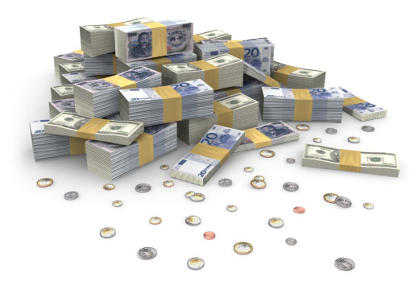
Why Business Continuity ?
Lost Productivity
Know the downtime costs (per hour, day, two days...)
Lost Revenue
Number of employees impacted (x hours out * hourly rate)
Direct loss
Compensatory payments
Lost future revenue
Billing losses
Investment losses
Damaged Reputation
Financial Performance
Customers
Suppliers
Financial markets
Banks
Business partners
Revenue recognition
Cash flow
Lost discounts (A/P)
Payment guarantees
Credit rating
Stock price
Other Expenses
Temporary employees, equipment rental, overtime costs, extra shipping costs, travel expenses...

Slide 56
Why high Dependability ?
Millions of US Dollars per Hour in Lost Revenue
Retail
1.1
Insurance
1.2
Information technology
1.3
Financial institutions
1.5
Manufacturing
1.6
Call location
1.6
Telecommunications
2.0
Credit card sales authorization
2.6
Energy
2.8
Point of sale
3.6
Retail brokerage
6.5
Source Meta Group, 2005

Slide 57
Information Availability(5个9)
% Uptime | % Downtime | Downtime per Year | Downtime per Week
98% | 2% | 7.3 days | 3hrs 22 min
99% | 1% | 3.65 days | 1 hr 41 min
99.8% | 0.2% | 17 hrs 31 min | 20 min 10 sec
99.9% | 0.1% | 8 hrs 45 min | 10 min 5 sec
99.99% | 0.01% | 52.5 min | 1 min
99.999% | 0.001% | 5.25 min | 6 sec
99.9999% | 0.0001% | 31.5 sec | 0.6 sec

Slide 58
Evolvement of Dependability-1
Reliability (可靠性) 1960s
----field of fault tolerance and system reliability
Definition
In general, reliability (systemic def.) is the ability of a person or system to perform and maintain its functions in routine circumstances, as well as hostile or unexpected circumstances.
The IEEE defines it as ". . . the ability of a system or component to perform its required functions under stated conditions for a specified period of time."
The Institute of Electrical and Electronics Engineers

Slide 59
Evolvement of Dependability-2
Dependability (可信性)
1985, Jean-Claude Laprie
J.C. Laprie. "Dependable Computing and Fault Tolerance: Concepts and terminology," in Proc. 15th IEEE Int. Symp. on Fault-Tolerant Computing, 1985
International Conference on dependable Systems and networks
International Symposium on Reliable Distributed Systems
International Symposium on Software Reliability Engineering.

Slide 60
Definition 1 of Denpendability
Computer system dependability is The quality of the delivered service such that reliance can justifiably be placed on this service.
J.C. Laprie. "Dependable Computing and Fault Tolerance: Concepts and terminology," in Proc. 15th IEEE Int. Symp. on Fault-Tolerant Computing, 1985
reliability, maintainability, availability, safety, are quantitative measures corresponding to distinct perceptions of the same attribute of a system: it’s dependability
general concept
Notes:
Error, fault, failure

Slide 61
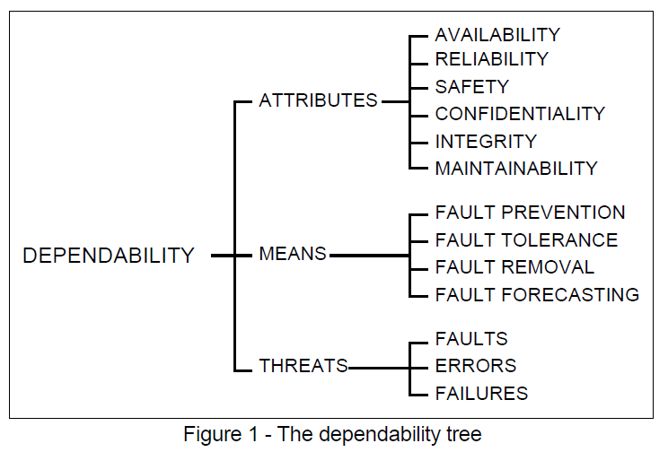
Definition 2 of Denpendability
A. Avizienis, J.-C. Laprie and B. Randell: Fundamental Concepts of Dependability. Research Report No 1145, , April 2001
Denpendability&
Security
Notes:
Error, fault, failure

Slide 62
Related concepts
Availability(可用性) - readiness for correct service
Reliability(可靠性) - continuity of correct service
Safety(平安性?) - absence of catastrophic consequences on the user(s) and the environment
Integrity(完整性) - absence of improper system alteration
Maintainability(可维护性) - ability to undergo modifications and repairs
Confidentiality(机密性), the absence of unauthorized disclosure of information
Security(安全保障) is a composite of Confidentiality, Integrity, and Availability.

Slide 63
Dependability(可信性)
Service level Agreements(SLA) / Service level objectives (SLO)
Service accomplishment
Service interruption
Failures:
S_{accomplishment} →S_{interruption}
Restorations:
S_{interruption} →S_{accomplishment}

Slide 64
Measurements of Dependability
Module reliability: continuous service accomplishment ( of the time to failure )
MTTF: Mean Time To Failure
MTTR: Mean Time To Repair (service interruption)
FIT: Failure In Time = 1/MTTF
MTBF: Mean Time Between Failure = MTTF+MTTR
Module availability
MTTF = MTTF
MTTF + MTTR MTBF

Slide 65
Example: disk system
Assumption:
10 disks, 1000000 hour MTTF
1 SCSI controller, 500000 hour MTTF
1 power supply, 1 fan, both 200000 hour MTTF
1 SCSI cable, 1000000 hour MTTF
Question: MTTR of the whole system
Answer:
Failure rate_{system} = 10*1/1000,000 + 1/500,000 + 1/200,000 + 1/100,000
= 23000/1000,000,000
MTTF_{system} = 1/Failure_{system} = 43500 hours ~ 5 years

Slide 66
Way to cope with failure
Redundancy:
Time redundancy: repeat the operation again to see if it is still in erroneous.
Resource redundancy: have other components to take over from the one that failed.

Slide 67
Dependability
Compare with
Trusted computing
Trustworthy computing
Credibility

Slide 68
Topics in Chapter
1.1 Why take this course ?
1.2 Classes of computers in current computer market
1.3 Defining computer architecture and What’s the task of computer design?
1.4 Trends in Technology
1.5 Trends in power in Integrated circuits
1.6 Trends in Cost
1.7 Dependability
1.8 Measuring, Reporting and summerizing Perf.
1.9 Quantitative Principles of computer Design
1.10 Putting it altogether

Slide 69
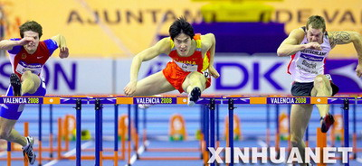
Performance

Slide 70
Measuring and Reporting Performance
Comparing Machines
Execution time (latency)
Throughput
MIPS - millions of instructions per second
Comparing Machines Using Sets of Programs
Choosing which program to evaluate performance
Benchmark Suites
Different Means: Arithmetic, Harmonic, and Geometric Means

Slide 71



Defining performance
Performance means different things to different people, therefore its assessment is subtle
different perception
Criteria of performance evaluation differs among users and designers
Just a piece of
cake ! Even for 50 guys
Faint ! When will
they bring me the meal?
Sorry, Lady is first !

Slide 72

Perf. Metrics --response time
Wall-clock time
Start the program and watch the clock -
when the program ends, that’s the total wall-clock time
Also called response time or elapsed time or
Measures user perception of the system speed
Problems with wall-clock time
What if more than one program is running on
the same machine ?
What if the program asks for user input ?

Slide 73
Performance Metrics --CPU time
Measures the time the CPU is computing, (not waiting for I/O)
Measures designer perception of the CPU speed
CPU time is further divided into:
User time - time spent in user mode
System time - time spent in the operating system (OS)
Unix time command reports CPU time as:
90.7u 12.9s 2:39 65%
90.7 user CPU seconds (in the user’s program)
12.9 system CPU seconds (in the system calls e.g. printf)
2 minutes, 39 seconds wall-clock time
65% of the wall clock time was spent running on the CPU

Slide 74
Performance Metrics --throughput
Amount of work done in a given time
Measure administrator perception of the system perf.
We often use throughput to measure
Number of lines of code per day
Number bits per second transmitted over a wire
Number of web pages served
In contrast to latency
amount of time to produce 1 line of code
amount of time to send 1 bit over a wire
Amount of time spent waiting to receive web page
Often, processor performance is only quoted in terms of relative latency
Program A ran 10 times faster than program B
But, for many apps, throughput much more important than latency
Financial markets, government statistics (census)

Slide 75
Response time vs. Throughput
If you improve response time, you usually improve throughput
Replacing the processor of a computer with a faster version
you can also improve throughput without improving response time
Adding additional processors to a system that uses multiple processors
for separate tasks (e.g. handling of airline reservations system)

Slide 76
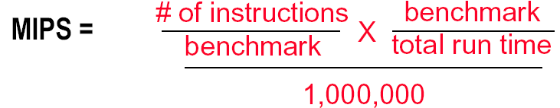
Another industry Metric: MIPS
MIPS - Millions of Instructions per Second
When comparing two machines (A, B) with the same instruction set, MIPS is a fair comparison(sometimes…)
But, MIPS can be a “meaningless indicator of performance…”

Slide 77
Ex: MIPS might be meaningless
Machine A has a special instruction for performing square root calculations. It takes 100 cycles to execute.
Machine B doesn’t have the special instruction -- must perform square root calculations in software using simple instructions (.e.g, Add, Mult, Shift) that each take 1 cycle to execute
Machine A: 1/100 MIPS = 0.01 MIPS
Machine B: 1 MIPS

Slide 78
Another view: Power consumption and Efficiency
Critical factors for embedded systems:
cost
physical size
memory
power consumption
Fig. 1.27
AMD ElanSC520
AMD K6-2E
IBM PowerPC 750CX
NEC VR 5432
NEC VR 4122
The NEC VR 4122 is the big
winner for its best performance/watt,
though it is the second lowest performing processor.

Slide 79
Summary of performance metrics
Response (Execution) time
user perception
system performance
the only unimpeachable measure of performance
CPU time
designer perception
CPU performance
Throughput
administrator perception
MIPS
merchant perception

Slide 80
Choose Programs to Evaluate Performance
Ideal performance evaluation:
A random sample of users running their programs and OS commands.
Many different types of benchmarks
Real applications--- Scientific and engineering
Modified (or scripted) applications--- focus on specific features
Kernels --- critical program fragments
Toy --- small programs, often measure very little
Synthetic -- created to represent some aspects of a program (e.g., mix of instruction types)
Database -- a world unto itself
What really matters is how YOUR application performs

Slide 81
Something about Synthetic
Synthetic benchmarks :
Programs that try to "exercise" the system in the same way to match the average frequency of operations and operands of a large set of programs.
Whetstone and Dhrystone.
Similar to kernels but are NOT real programs !
Compiler and hardware optimizations can artificially inflate performance of these benchmarks but not of real programs.
These benchmarks don’t reward optimizations!
SQRT(EXP(x))= √e ^{x} = e ^{x/2} = EXP(X/2)

Slide 82
Notes on performance benchmark
Benchmarks can focus on specific aspects of a system
floating point & integer ALU, memory system, I/O, OS
Universal benchmarks can be misleading since hardware and compiler vendors might optimize their design for ONLY these programs
The best types of benchmarks are real applications since they reflect the end-user interest
Architectures might perform well for some applications and poorly for others
Compilation can boost performance by taking advantage of architecture-specific features. Application-specific compiler optimization are becoming more popular.

Slide 83
SPEC
SPEC - The System Performance Evaluation Cooperative
founded in 1988 by a small number of workstation vendors who realized that the marketplace was in desperate need of realistic, standardize performance tests.
Grown to become successful performance standardization bodies with more than 40 member companies.
http://www.spec.org
SPEC's Philosophy
The goal of SPEC is to ensure that the marketplace has a fair and useful set of metrics to differentiate candidate systems.
The basic SPEC methodology is to provide the benchmarker with a standardized suite of source code based upon existing applications

Slide 84
SPEC benchmarks Desktop Benchmarks
CPU-intensive benchmarks
SPEC89
SPEC92
SPEC95
SPEC2000
SPEC CPU2006 ( 12 CINT2006, 17 CFP2006)
graphics-intensive benchmarks
SPEC2000
SPECviewperf
is used for benchmarking systems supporting the OpenGL graphics library
SPECapc
consists of applications that make extensive use of graphics.

Slide 85
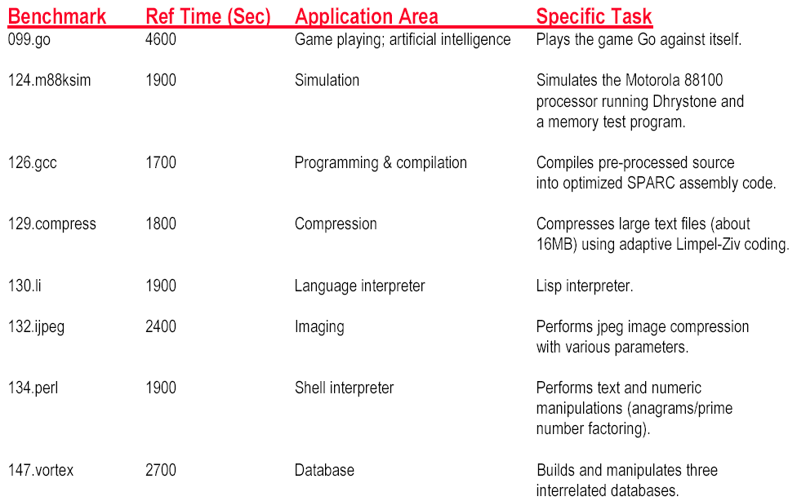
SPEC INT 95 Benchmark descriptions

Slide 86
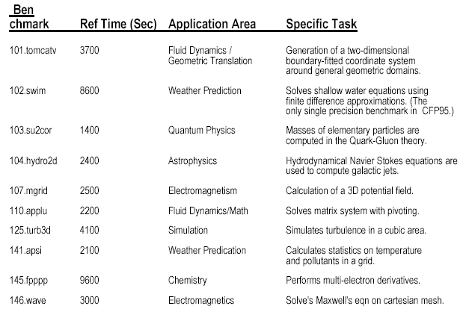
SPEC FP 95 Benchmark Descriptions

Slide 87
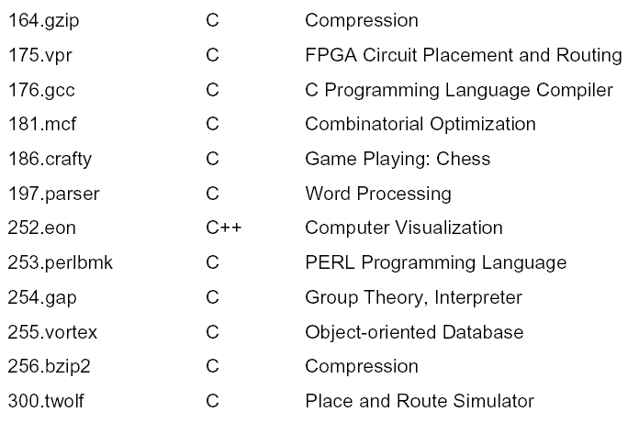
New SPEC Int 2000 Benchmarks

Slide 88
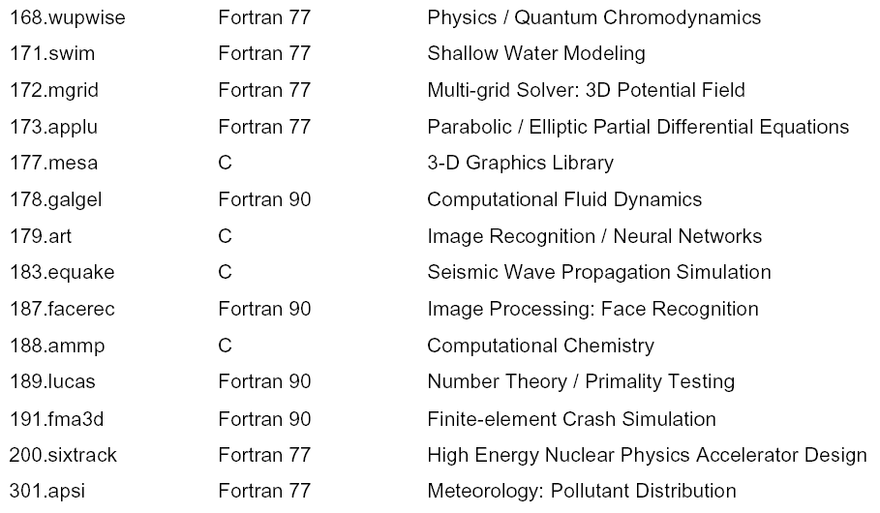
New SPEC FP 2000 Benchmarks

Slide 89
SPEC benchmarks Server Benchmarks
SPECrate--processing rate of a multiprocessor
SPEC CPU2000—throughput-oriented benchmark
SPECrate—processing rate of a multiprocessor
SPECSFS--file server benchmark
SPECWeb--Web server benchmark
Transaction-processing (TP) benchmarks
TPC benchmark—Transaction Processing Council
TPC-A, 1985
TPC-C, 1992,
TPC-H→ TPC-R→TPC-W

Slide 90
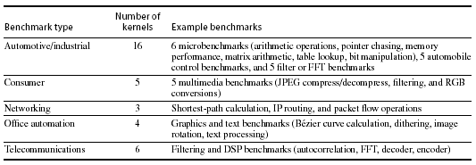
SPEC benchmarks Embedded Benchmarks
EDN Embedded Microprocessor Benchmark Consortium (or EEMBC, pronounced “embassy”).

Slide 91
Running Benchmarks
Key factor: Reproducibility by other experimenters.
Details, details, and more details !!! List all assumptions and conditions of your experiments.
i.e. program input, version of the program, version of the compiler, optimization level, OS version, main memory size, disk types, etc.
A system’s software configuration can significantly affect the performance results for a benchmark.

Slide 92
Comparing Two Machines
Machine CPI Clock Period Avg Instruction Time (secs)
Machine A 1.2 2 ns
Machine B 2.5 1 ns
CPU Time = # of instructions executed * avg instruction time
Assume 1,000,000, 000 instructions
Machine A: 1,000,000,000 * 2.4ns = 2.4 seconds
Machine B: 1,000,000,000 * 2.5ns = 2.5 seconds
Which machine is faster? Machine A
How much faster? 2.5 / 2.4 = 1.04 times faster

Slide 93
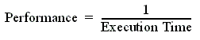
Comparing Performance
Often, we want to compare the performance of different machines or different programs. Why?
To help engineers understand which is “better”
To give marketing a “silver bullet” for the press release
To help customers understand why they should buy <my machine>
Performance and Execution time are reciprocals
Maximizing performance means minimizing response (execution) time

Slide 94
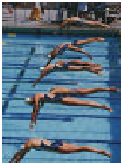
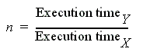
Common used phrases
“Performance of P₁ is better than P₂ ” is, for a given work load L, P₁ takes less time to execute L than P₂ does
performance(P1) > Performance(P2)
⇒ Execution Time(P1, L) < Execution Time(P1, L)
“Processor X is n times fast than Y” is

Slide 95
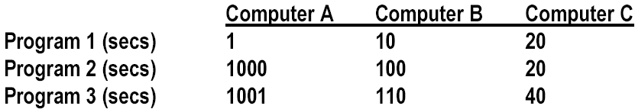
Comparing Performance Across Multiple Programs
A is 10 times faster than B for program 1
B is 10 times faster than A for program 2
A is 20 times faster than C for program 1
C is 50 times faster than A for program 2
B is 2 times faster than C for program 1
C is 5 times faster than B for program 2
Each statement above is correct…,
…but we want to know which machine is the best?

Slide 96
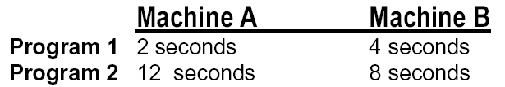
Let’s Try a Simpler Example
Two machines timed on two benchmarks
How much faster is Machine A than Machine B?
Attempt 1: ratio of run times, normalized to Machine A times
program1: 4/2 program2 : 8/12
Machine A ran 2 times faster on program 1, 2/3 times faster on program 2
On average, Machine A is (2 + 2/3) /2 = 4/3 times faster than Machine B
It turns this “averaging” stuff can fool us

Slide 97
Example: Second answer
Two machines timed on two benchmarks
How much faster is Machine A than Machine B?
Attempt 2: ratio of run times, normalized to Machine B times
program 1: 2/4 program 2 : 12/8
Machine A ran program 1 in 1/2 the time and program 2 in 3/2 the time
On average, (1/2 + 3/2) / 2 = 1
Put another way, Machine A is 1.0 times faster than Machine B

Slide 98
Example: Third answer
Two machines timed on two benchmarks
How much faster is Machine A than Machine B?
Attempt 3: ratio of run times, aggregate (total sum) times,
Machine A took 14 seconds for both programs
Machine B took 12 seconds for both programs
Therefore, Machine A takes 14/12 of the time of Machine B
Put another way, Machine A is 6/7 faster than Machine B

Slide 99
Which is Right?
Question:
How can we get three different answers?
Solution
Because, while they are all reasonable calculations…
…each answers a different question
We need to be more precise in understanding and posing these performance & metric questions

Slide 100
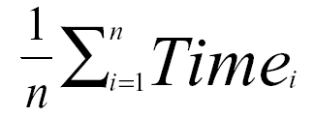
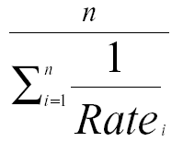
Arithmetic and Harmonic Mean
Total Execution Time: A Consistent Summary Measure
Arithmetic mean is the average of the execution time that tracks total execution time.
If performance is expressed as a rate, then the average that tracks total execution time is the harmonic mean
Notes:
harmonic [hɑ:'mɔnik]
adj. 和声的；谐和的；音乐般的
n. [物] 谐波；和声

Slide 101
Problems with Arithmetic Mean
Applications do not have the same probability of being run
Longer programs weigh more heavily in the average
For example, two machines timed on two benchmarks
Machine A Machine B
Program 1 2 seconds (20%) 4 seconds (20%)
Program 2 12 seconds (80%) 8 seconds (80%)
If we do arithmetic mean, Program 2 “counts more” than Program 1
an improvement in Program 2 changes the average more than a proportional improvement in Program 1
But perhaps Program 1 is 4 times more likely to run than Program 1

Slide 102
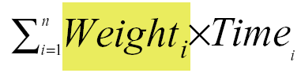
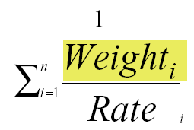
Weighted Execution Time
Often, one runs some programs more often than others. Therefore, we should weight the more frequently used programs’ execution time
Weighted Harmonic Mean

Slide 103

Using a Weighted Sum (or weighted average)
Allows us to determine relative performance 10/7.2 = 1.38
--> Machine B is 1.38 times faster than Machine A

Slide 104

Another Solution
Normalize run time of each program to a reference
So when we normalize A to B, and average, it looks like A & B are the same.
But when we normalize B to A, it looks like B is 33% better!

Slide 105


Example
33744 1
W(B)₁= ⎯⎯⎯⎯⎯⎯⎯⎯⎯ = 0.909
10×(1/10＋1/100)
1
W(B)2= ⎯⎯⎯⎯⎯⎯⎯⎯⎯ = 0.091
100×(1/10＋1/100)
Equal-time weighting

Slide 106

Geometric Mean
Used for relative rate or performance numbers
Geometric mean’s nice property
Geometric mean(Xi) Xi
Geometric mean(Yi) Yi
=Geometric mean( )

Slide 107

Using Geometric Mean
Drawback:
Geometric mean does NOT predict run time
Normalizes.
Each application now counts equally.
Advantage: Irrelevance of the reference computer in relative performance

Slide 108
Summary of comparing performance
Total execution time or arithmetic mean
consistent result
programs in the workload are NOT always run an equal number of times
Weighted arithmetic mean
take into account the frequency of use in the workload
solution depends on which machine is the reference.
Normalized Geometric Mean---SPEC Ratio
consistent result, no matter which machine is the reference.
Geometric mean does NOT predict run time
Ideal solution : Measure a real workload and weight the programs according to their frequency of execution.
What really matters is how YOUR application performs

Slide 109

New SPEC Performance Numbers
Geometric Mean of 12 (SpecInt) and 14 (SpecFP) Benchmarks
Performance measured against SPARC 10/40
2000 Performance Numbers (Microprocessor Report, Dec. 2000)

Slide 110

New SPEC Performance Numbers
Geometric Mean of 12 (SpecInt) and 14 (SpecFP) Benchmarks
Performance measured against SPARC 10/40
2001 Performance Numbers (Microprocessor Report, Aug. 2001)

